Slide 1
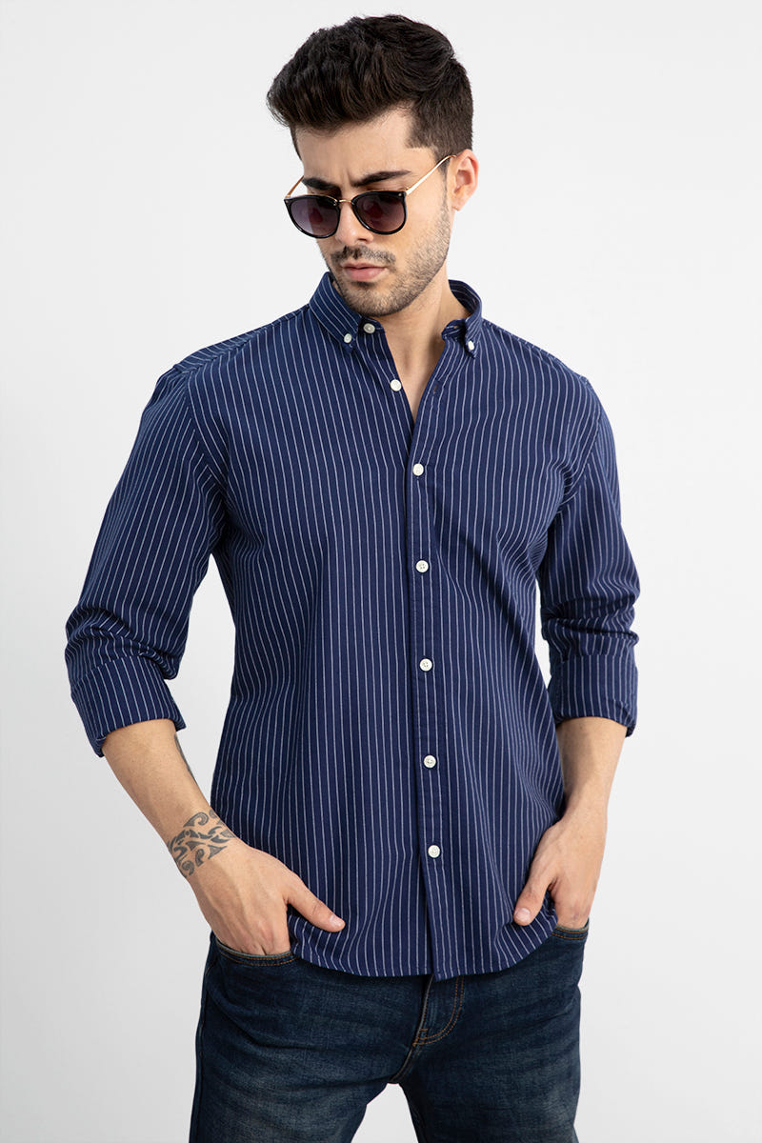
INDEPENDENT BRAND STRATEGY
SNITCH
Beyond
the drop
A content strategy for demand
between product launches
Jyoti Vashisth
Notes:
Source: Jyoti Vashisth, supplied Case Studies new.pdf, pages 16–35. Independent strategic exercise. Not commissioned by or affiliated with Snitch. No executed campaign results claimed. My concept extends the original product-content audit into a connected content system. Product photograph: site/public/case-visuals/snitch-shirt.jpg, supplied workspace asset.

Slide 2
SNITCH
TL;DR
02
The strategy in 30 seconds
MY AUDIT
Snitch makes new products worth noticing. I saw room for stronger brand meaning between launches.
MY PROPOSAL
I connected cultural stories with community participation, contextual shopping and owned relationships.
MY EXECUTION PLAN
Three recurring concepts, five channel roles and a worked First Salary campaign.
MY TEST
Compare behaviour with existing content. I would judge repeat attention and commercial value together.
Independent exercise. The campaign examples are proposals, not completed Snitch work.
Notes:
Source: Jyoti Vashisth, supplied Case Studies new.pdf, pages 16–35. Independent strategic exercise. Not commissioned by or affiliated with Snitch. No executed campaign results claimed. The original audit praises Snitch’s current creative strength. My recommendation adds another role for content while retaining product launches.

Slide 3
SNITCH
CONTENT AUDIT
03
What I found in the original audit
My outside-in observations of the existing content engine
FRIDAY DROPS
A recurring release format creates a reason to check back. I would preserve that audience habit.
CAMPAIGN WORLDS
Collections use visual worlds and characters. Product announcements already have creative distinction.
CULTURAL ENTRY POINTS
Work, travel, festivals and humour make commercial messages easier to engage with.
THE OPEN QUESTION
Would customers recognise a consistent Snitch perspective even when no new collection is launching?
The opportunity I identified: give audiences a reason to engage between purchases.
Notes:
Source: Jyoti Vashisth, supplied Case Studies new.pdf, pages 16,18–19. Independent strategic exercise. Not commissioned by or affiliated with Snitch. No executed campaign results claimed. These are observations documented in the supplied audit, not a newly quantified social-media audit. Before a live pitch I would attach dated campaign examples and validate these observations with Snitch’s team.

Slide 4
SNITCH
BUSINESS CONTEXT
04
A larger brand needs demand across channels
Reported FY26 context supports the importance of a connected strategy
₹900 cr
~80%
60 / 40
Operating revenue
Year-on-year growth
Online / offline mix
Reported unaudited FY26 revenue
Reported growth from the prior year
Approximate revenue share, in percent
My implication
A social idea should help customers shop and return across digital and retail touchpoints.
Source: CEO-reported unaudited figures, covered by Inc42 in 2026. Brand context, not my results.
Notes:
Source: Jyoti Vashisth, supplied Case Studies new.pdf, pages 18,21. Independent strategic exercise. Not commissioned by or affiliated with Snitch. No executed campaign results claimed. I use these figures to explain why channel coordination matters. Revenue scale cannot demonstrate that my content proposal will work.
Additional source: https://inc42.com/buzz/d2c-brand-snitchs-fy26-revenue-surges-80-to-%E2%82%B9900-cr/

Slide 5
SNITCH
AUDIENCE EVIDENCE
05
Listening and assortment matter in apparel
22%
46%
Empathy’s weight in apparel
customer experience
Likely to switch if support
or range falls short
How I used the evidence
I would use participation to understand customers, then merchandise the range around their situations. Content alone cannot fix service or assortment.
KPMG India CX Report 2025, apparel segment. Category evidence, not Snitch customer data. Sample size not stated on the segment page.
Notes:
Source: Jyoti Vashisth, supplied Case Studies new.pdf, pages 21–22. Independent strategic exercise. Not commissioned by or affiliated with Snitch. No executed campaign results claimed. Empathy has 22% weight, with integrity at 20%. The 46% switching finding relates to insufficient support or range. This evidence motivates listening and relevant merchandising, not a forecast of conversion lift.
Additional source: https://kpmg.com/in/en/insights/2025/03/india-cx-report-2025/retail/apparel.html

Slide 6
SNITCH
AUDIENCE AND CUSTOMER JOB
06
My first theme: entering working life
A proposed pilot audience, not a validated Snitch segment
First salary.
New routines.
Different expectations.
THE CUSTOMER JOB
Help me dress for the life I am entering without replacing my whole wardrobe.
I would test this with community responses and customer interviews before committing production spend.
The theme links a recognisable life moment to workwear and versatile everyday pieces.
Notes:
Source: Jyoti Vashisth, supplied Case Studies new.pdf, pages 21–22,25–26,33–34. Independent strategic exercise. Not commissioned by or affiliated with Snitch. No executed campaign results claimed. First Salary is the source’s illustrative theme. I prioritise it as a pilot because it offers a coherent route from life-stage conversation into workwear merchandising. Audience prevalence, budget and product demand require validation.

Slide 7
SNITCH
STRATEGY ARCHITECTURE
07
Four layers of one content system
01
Cultural observation
Build memory beyond a launch.
A recognisable perspective on young men’s changing lives.
02
Community intelligence
Learn before prescribing.
Real responses and creator stories reveal what matters.
03
Commerce in context
Make product choice easier.
Useful edits connect those situations with the range.
04
Owned relationship
Create reasons to return.
Email, app, WhatsApp and retail continue the theme.
Notes:
Source: Jyoti Vashisth, supplied Case Studies new.pdf, pages 21–23. Independent strategic exercise. Not commissioned by or affiliated with Snitch. No executed campaign results claimed. The original strategy has four layers. The three recurring creative properties on the next slides execute the first three, while owned channels extend the relationship.

Slide 8
SNITCH
CREATIVE CONCEPT 01
08
The New Codes
My recurring editorial format for changing expectations
“Office wear stopped
looking like office wear.”
FORMAT
CREATIVE BRIEF
A short observation, a human story and a question the audience can answer.
Show the tension between old rules and lived experience. Fashion sits inside the story.
Illustrative copy. Proposed formats: Reels, carousels and street conversations.
Notes:
Source: Jyoti Vashisth, supplied Case Studies new.pdf, pages 33. Independent strategic exercise. Not commissioned by or affiliated with Snitch. No executed campaign results claimed. Other original themes include first salary, male skincare, changing friendships and changing definitions of success. I would select themes through audience evidence and avoid presenting the brand as a life-advice authority.

Slide 9
SNITCH
CREATIVE CONCEPT 02
09
Snitch, Tell Me
A recurring community question that creates stories and research
What was the first thing
you bought when you
started earning?
HOW I WOULD USE RESPONSES
Invite real answers.
Group recurring motivations.
Ask permission to feature
selected stories.
I would turn repeated themes into creator briefs, edits and customer research questions.
Notes:
Source: Jyoti Vashisth, supplied Case Studies new.pdf, pages 33–34. Independent strategic exercise. Not commissioned by or affiliated with Snitch. No executed campaign results claimed. Examples in the source include gifts for parents, rent, travel and personal purchases. They are possibilities, not collected responses. Proposed operating safeguards: consent to reuse submissions, moderation, no inference of sensitive financial traits.

Slide 10
SNITCH
CREATIVE CONCEPT 03
10
Life Edits
My merchandising concept for recognisable situations
The First
Paycheque Edit
First-day pieces
Office to evening
Friday dressing
Work travel
Versatile basics
A wardrobe for the version of you
who now has meetings.
I would give each edit a clear shopping purpose, with relevant stock and fit information.
Notes:
Source: Jyoti Vashisth, supplied Case Studies new.pdf, pages 26,34. Independent strategic exercise. Not commissioned by or affiliated with Snitch. No executed campaign results claimed. The source also proposes The 48-Hour Edit, The First-Date Edit and The Moving Out Edit. I would prioritise one theme, then expand based on product discovery and demand rather than launch every property at once.

Slide 11
SNITCH
WORKED CAMPAIGN
11
First Salary: my social opening
Illustrative three-frame carousel, not a published Snitch campaign
01
02
03
Your first salary.
Your old college
wardrobe.
The first meeting.
The same favourite
shirt.
What did you buy
for yourself first?
Recognise a life change.
Keep the story grounded
in real habits.
Invite a response before
introducing the edit.
Notes:
Source: Jyoti Vashisth, supplied Case Studies new.pdf, pages 25,33–34. Independent strategic exercise. Not commissioned by or affiliated with Snitch. No executed campaign results claimed. Execution extension: the exact three-frame copy is my proposed illustration of the source strategy. It earns recognition and participation before the shopping message. I would test whether this framing resonates rather than assume it does.

Slide 12
SNITCH
CREATOR EXECUTION
12
My creator brief keeps the story personal
THE QUESTION
What did your first salary change about how you dressed?
THE STORY
Use one specific memory and a real outfit. Let each creator bring their city, job and experience.
THE PRODUCT ROLE
Show an eligible Snitch piece when it fits the story. Keep claims factual and sponsorship visible.
THE HANDOFF
Invite replies, then link to the relevant edit with a trackable creator link.
I would approve the theme and product facts, while preserving each creator’s own voice.
Notes:
Source: Jyoti Vashisth, supplied Case Studies new.pdf, pages 25–26. Independent strategic exercise. Not commissioned by or affiliated with Snitch. No executed campaign results claimed. The source changes creators’ role from distribution to cultural contribution. Exact briefing steps and disclosure controls are proposed implementation detail. Creator selection would consider audience overlap, story credibility, content quality and cost per qualified visit.

Slide 13
SNITCH
DISTRIBUTION
13
One theme, five distinct channel jobs
SURFACE
JOB
EXECUTION
SIGNAL
SOCIAL
Recognition
A first-salary observation
Shares and qualified visits
CREATORS
Participation
Personal stories and replies
Submissions and returning viewers
WEB / APP
Product discovery
The First Paycheque Edit
Product visits and add-to-cart
CRM
A relevant return
Guidance based on interest or purchase
Revenue per recipient and opt-outs
RETAIL
Physical discovery
An edit customers can try
Tracked visits and basket mix
I would adapt the theme to the channel’s job rather than repeat the same asset everywhere.
Notes:
Source: Jyoti Vashisth, supplied Case Studies new.pdf, pages 25–27. Independent strategic exercise. Not commissioned by or affiliated with Snitch. No executed campaign results claimed. The channel roles and measures retain the source’s funnel logic. Retail tracking is an implementation proposal and needs store operations and analytics support.

Slide 14
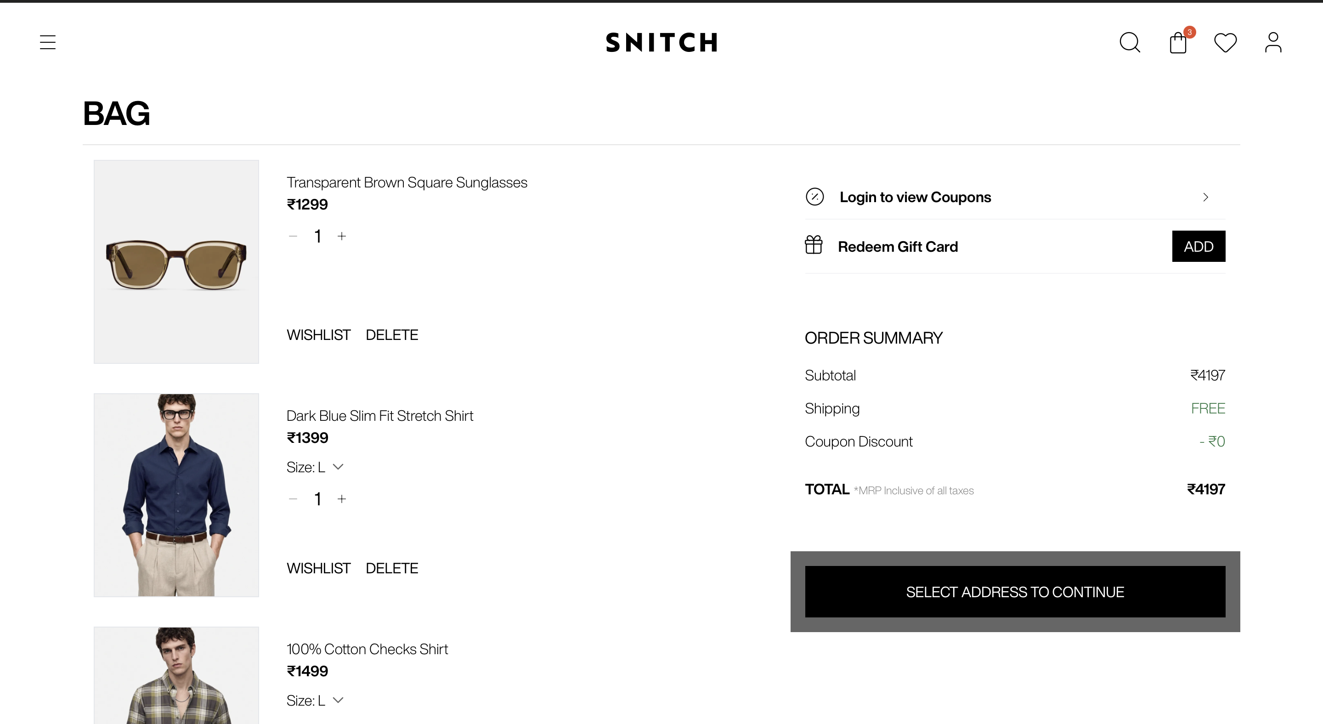
SNITCH
COMMERCE EXECUTION
14
A story needs a useful shopping destination
Existing Snitch bag screenshot supplied with the portfolio assets
MY PROPOSED EDIT
First day
Office to evening
Friday dressing
I would group products by situation, retain sizing and price clarity, and link each story to the right edit.
The screenshot is current-state context. The edit structure is my proposed addition.
Notes:
Source: Jyoti Vashisth, supplied Case Studies new.pdf, pages 26,34. Independent strategic exercise. Not commissioned by or affiliated with Snitch. No executed campaign results claimed. Screenshot: site/public/case-visuals/snitch-bag.png, supplied workspace asset, capture date unknown. This bag view does not prove a conversion problem. My proposal tests context-led merchandising against generic category navigation, with inventory and product facts kept consistent.

Slide 15
SNITCH
LIFECYCLE EXECUTION
15
My CRM logic follows the customer’s behaviour
Proposed branches for the First Paycheque Edit
BROWSED, NO PURCHASE
Offer one useful edit or fit detail. Stop if there is no fresh signal or channel permission.
BOUGHT WORKWEAR
After delivery, show ways to wear the piece. Later offer a complementary category when relevant.
RETURN / SUPPORT OPEN
Suppress sales messages and prioritise resolution. Resume only when the issue is closed.
REPEAT CUSTOMER
Use category history and stated preferences. Test a related Life Edit against the existing message.
I would measure incremental value alongside unsubscribes, complaints and frequency.
Notes:
Source: Jyoti Vashisth, supplied Case Studies new.pdf, pages 26,30. Independent strategic exercise. Not commissioned by or affiliated with Snitch. No executed campaign results claimed. The original source proposes useful editorial CRM and complementary recommendations. Delivery gates, service suppressions and preference controls are my proposed implementation detail. Timing requires shipping and engagement data, not arbitrary day-based messages.

Slide 16
SNITCH
RETAIL AND OPERATING PLAN
16
The same idea continues in store
Your first
work wardrobe
RETAIL EXECUTION
A curated rail with in-stock sizes. Staff pairing suggestions. A QR link to the same edit.
Proposed retail headline
MY TEAM HANDOFFS
Creative: theme and assets
Merchandising: assortment and inventory
CRM: triggers and suppressions
Analytics + retail: events and store codes
I would keep product availability, pricing and the campaign message consistent across touchpoints.
Notes:
Source: Jyoti Vashisth, supplied Case Studies new.pdf, pages 26–27. Independent strategic exercise. Not commissioned by or affiliated with Snitch. No executed campaign results claimed. The original source connects cultural themes to physical edits. Handoff deliverables and QR/store-code tracking extend the proposal. No store display or retail campaign has been implemented for this exercise.

Slide 17
SNITCH
MEASUREMENT
17
My scorecard separates attention from value
CONTENT RESPONSE
Share rate, completion and participation show whether the theme earns active interest.
BRAND RESPONSE
Recall and association tracking test whether people remember a distinct Snitch perspective.
SHOPPING RESPONSE
Edit visits, product clicks and add-to-cart show whether the story helps customers navigate.
RELATIONSHIP VALUE
CRM revenue per recipient, repeat purchase and cross-category buying need longer cohort observation.
Branded search and direct traffic provide context. They do not establish content causality.
Notes:
Source: Jyoti Vashisth, supplied Case Studies new.pdf, pages 29–31. Independent strategic exercise. Not commissioned by or affiliated with Snitch. No executed campaign results claimed. The framework keeps content, brand and commercial response separate. Returning contributors and comment quality provide qualitative depth. I would predefine reporting windows, platform metric definitions and cohorts before the test.

Slide 18
SNITCH
EXPERIMENT PLAN
18
Four tests against the existing baseline
Cultural POV / product drops
Match audience, format and spend
Shares ÷ reach; video completion
Community / standard creator brief
Review quality with a fixed rubric
Valid responses ÷ reached users
Life Edit / category page
Randomise eligible traffic if feasible
Product visits and add-to-cart per session
Editorial CRM / existing message
Hold offer and audience eligibility steady
Attributed revenue ÷ delivered recipients
I would agree thresholds from the baseline before testing. No lift target is claimed here.
Notes:
Source: Jyoti Vashisth, supplied Case Studies new.pdf, pages 30. Independent strategic exercise. Not commissioned by or affiliated with Snitch. No executed campaign results claimed. The source proposes these four baseline comparisons. Denominators, controls and randomisation are execution extensions. Organic post comparisons are directional because timing, reach and algorithm effects differ. Randomised CRM and landing-page tests can provide stronger causal evidence.

Slide 19
SNITCH
PROPOSED PILOT
19
My first six-week pilot
An implementation extension to the original strategy
WEEKS 1–2
WEEKS 3–4
WEEKS 5–6
Validate and prepare
Publish and connect
Read the early signals
Review real responses. Confirm the theme, stock, consent and measurement.
Release the social opening, creator stories and shopping edit. Start eligible CRM branches.
Compare response and shopping behaviour. Interview participants and review weak handoffs.
Output: brief, edit, assets and event spec.
Check: working links, stable stock, relevant traffic.
Decision: improve, expand or pause the theme.
Repeat purchase and lifetime value require follow-up beyond the six-week pilot.
Notes:
Source: Jyoti Vashisth, supplied Case Studies new.pdf, pages 25–31,33–35. Independent strategic exercise. Not commissioned by or affiliated with Snitch. No executed campaign results claimed. The six-week schedule is a proposed execution plan, not a period stated in the source. It produces early directional learning while keeping retention claims separate from short-term response. No production budget or baseline is available, so none is invented.

Slide 20
SNITCH
DECISION RULES
20
How I would act on the result
SHARES, FEW PRODUCT VISITS
Review the story-to-edit handoff. The theme may resonate without creating a shopping need.
CLICKS, LOW ADD-TO-CART
Check relevance, stock, price and fit information before changing the creative.
CRM REVENUE, MORE OPT-OUTS
Review frequency and customer value. A short-term sale can weaken the relationship.
REPEAT VALUE ACROSS CHANNELS
Expand the strongest theme and reuse the operating system. Keep a control where feasible.
I would document what customers taught me and feed it into the next brief.
Notes:
Source: Jyoti Vashisth, supplied Case Studies new.pdf, pages 29–35. Independent strategic exercise. Not commissioned by or affiliated with Snitch. No executed campaign results claimed. These decision rules extend the original content learning loop. I would use evidence from customers and channel behaviour together rather than treat a single performance metric as a verdict.

Slide 21
SNITCH
CASE SUMMARY
21
What this case shows
My strategy links
brand meaning
with buying behaviour.
I audited the content, shaped the opportunity and designed a connected execution and measurement plan.
Jyoti Vashisth
Independent exercise. No Snitch campaign outcome claimed.
Notes:
Source: Jyoti Vashisth, supplied Case Studies new.pdf, pages 16–35. Independent strategic exercise. Not commissioned by or affiliated with Snitch. No executed campaign results claimed. The source includes assistant-facing drafting advice at its end. I have excluded that advice from the portfolio narrative. The deck uses first-person ownership for completed strategy work and conditional language for proposed implementation.

