Slide 1



Nitro Website Audit
https://nitrocommerce.ai/
SEO Audit

Slide 2
Index
Business Objectives
  What we want to achieve
  KPIs we are targeting
Strategic Roadmap
  Component Mapping
Website analysis
  Indexability & Crawlability
  Search Engine Readiness
  Rankability
  Traffic analysis
Traffic & Competitor Analysis
  Website Traffic Trend
5.
Strategic approach to SEO content
Search Areas to dominate
Content Creation & Distribution overview Dominate
Technical Errors
Backlink Analysis
Website overview
Competitor Analysis
3 Months SEO Strategy
3 Months On Page Plan
3 Months Off Page Plan

Slide 3
SEO Objective
Improve Organic Traffic and Engagement
Get Visibility on SERP for Relevant Non-Brand Queries
Other technical hygiene activities for sustainability of website
Improve Organic Lead

Slide 4
Strategic Roadmap

Slide 5
Component Mapping to Achieve Target KPIs
Objective | Component Mapping
To get ranking for keywords (Weightage - 30%) | Keyword Orbit Selection Keyword to Page Mapping Google Search Engine Optimization
To improve traffic on the website (Weightage - 20%) | Onpage Optimization Content Addition and improvisation Link Building through Offpage SEO
Improve Website Engagement (Weightage - 20%) | Speed Optimization Mobile Usability Optimization Website CTA Addition Internal Linking Website Structural improvement
To improve organic leads, Sales(Weightage - 20%) | Target conversion specific keywords on website Website CTA Addition
Monitor Hygiene Parameter on Regular interval(Weightage - 10%) | Website Hygiene Check on Regular Interval Tracking events on the website

Slide 6
SEO Parameters Checklists
Indexability & Crawlability
Search Engine Readiness
Rankability

Slide 7
Indexability & Crawlability

Slide 8
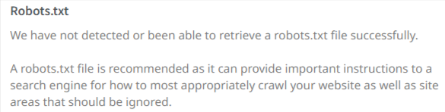
Robots.txt
Robots.txt instructs search engines about pages, files or directories that you don't wish to be indexed or accessed by web users.
This ensures the security of your website and the best possible results with your search engine optimization.
Currently website does have Robots.txt but will suggest if any scope of optimization in future

Slide 9
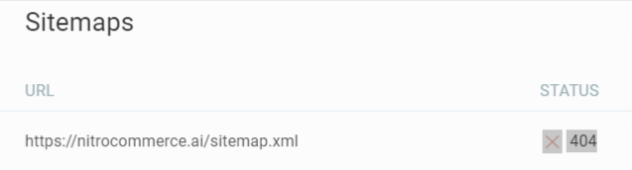
Sitemap
We checked and found that website has no sitemap present.

Slide 10
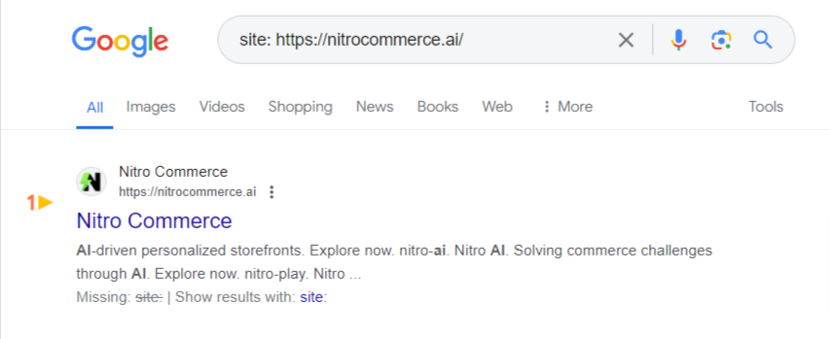
Indexed Pages in Google
We checked and found that 4 pages are indexed in Google

Slide 11
Search Engine Readiness

Slide 12
Website Speed Insights
Website speed is crucial to your SEO health. Every additional 0.5s it takes to load your site drastically increases the % of visitors that will leave your site.

Slide 13
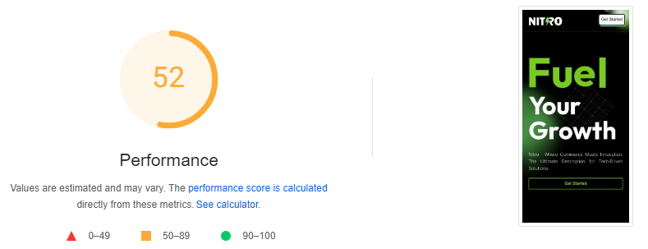
Mobile Speed Insights
Website loading speed on mobile is slow, As half and more users do searches from their mobile, mobile speed should be faster. There is a scope of improvement here.

Slide 14
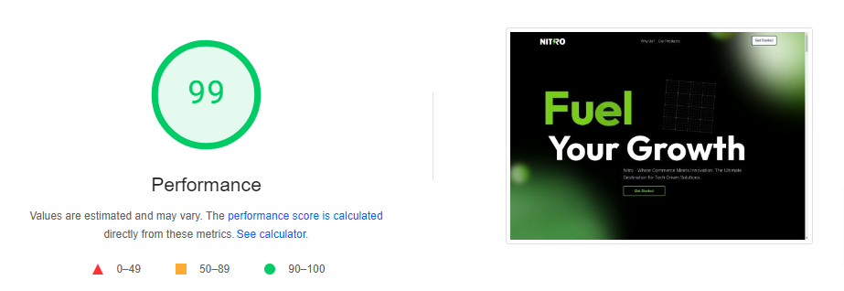
Desktop Speed Insights
Website Desktop loading speed is great.

Slide 15
Rankability

Slide 16
HTML Sitemap
HTML Tags help search engines understand exactly what your content is discussing. This is how Google creates the snippets you'll sometimes see when looking for a topic.
On-page optimization helps you to rank well in the Search Engines and also helps in improving the overall readability of your website for your users.
Currently, HTML sitemap is not present on the website.

Slide 17
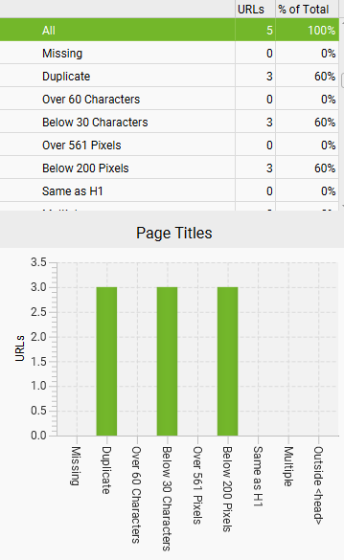
Title Tag
Keyword-rich title tags are essential to ranking well. Use them to your advantage. For the best results, keep your title tag under 60 characters and use relevant keywords. If you use more than 60 characters, you risk getting your title tag cut off by Google.
5 meta titles were found.
5 duplicate meta titles were found.

Slide 18
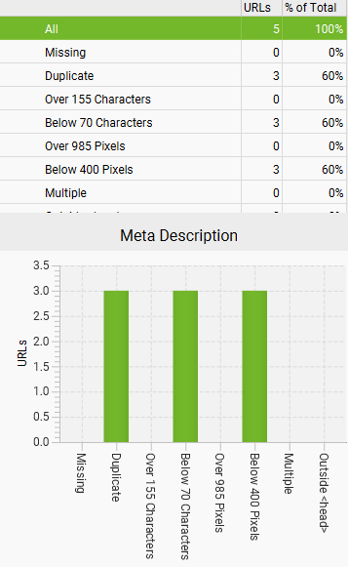
Meta Description
Meta description works as an advertising Copy, and draws the readers to the website from the SERP. keep your description under 120 characters and use relevant keyword in it. This need to be updated, as it improves the Direct Click Through Rate, which is key ranking factor.
5 meta descriptions were found.
5 missing meta descriptions were found.

Slide 19
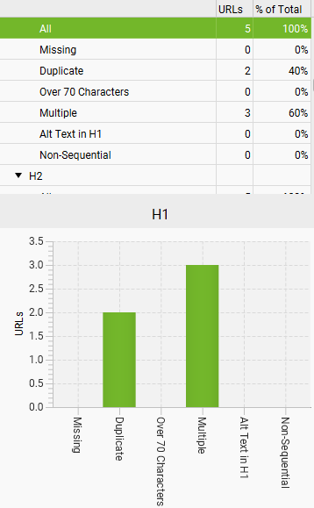
Header Tags
A page’s Header tag is a chance for a second less important title tag. This needs to be updated with targeted Keywords.
We observed Keywords rich header tags optimization is required
We observed 2 duplicate H1 tags are present on the website

Slide 20
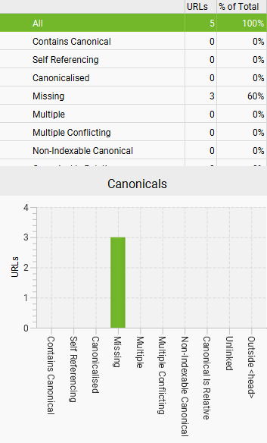
Canonical Tag
A canonical tag is a way of telling search engines that a specific URL represents the master copy of a page. Using the canonical tag prevents problems caused by identical or "duplicate" content appearing on multiple URLs.
3 missing canonical found on the website

Slide 21
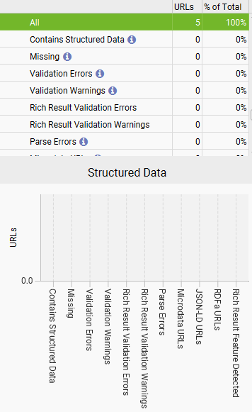
Schema(Structured Data)
Schema markup not present on the website.
Schema markup helps search engines understand your site's content better.
Improve brand presence with a full Knowledge Graph.
Get attention-grabbing rich results to increase CTR.
- No pages have structured data.

Slide 22
Our Strategic Approach to SEO Content

Slide 23
Search Areas to Dominate
The following SERP features needs to be dominated for the keywords that we are targeting. Optimizing the website with relevant keywords and content types would help us dominate these areas.
Dominating these areas will help in better keyword ranking, traffic to the website and CTR.
Keyword Ranking
Technical fixation
New Services pages
FAQ

Slide 24
Content Creation & Distribution Overview
Targeting the most searched/trending topics will be done to capture the search market and fulfill the objective of improving keyword rankings and traffic to business pages.
Content Categories:
Web Page Content on Targeted Keywords
Current trending blogs related to the performance marketing.
3rd Party Contents for Link building.

Slide 25
Technical Errors

Slide 26
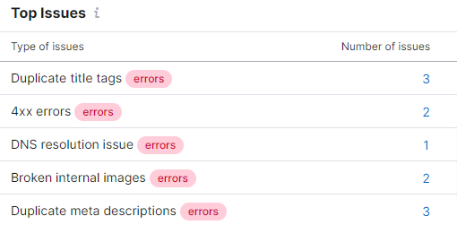
TECHNICAL ISSUES DETECTED
Duplicate title tags
Duplicate <title> tags make it difficult for search engines to determine which of a website's pages is relevant for a specific search query, and which one should be prioritized in search results. Pages with duplicate titles have a lower chance of ranking well and are at risk of being banned.
4xx errors
A 4xx error means that a webpage cannot be accessed. This is usually the result of broken links. These errors prevent users and search engine robots from accessing your webpages, and can negatively affect both user experience and search engine crawlability. This will in turn lead to a drop in traffic driven to your website.
DNS resolution issue
A DNS resolution error is reported when our crawler can't resolve the hostname when trying to access your webpage.
Broken internal images
An internal broken image is an image that can't be displayed because it no longer exists, its URL is misspelled, or because the file path is not valid. Broken images may jeopardize your search rankings because they provide a poor user experience and signal to search engines that your page is low quality.
Duplicate meta descriptions
A <meta description> tag is a short summary of a webpage's content that helps search engines understand what the page is about and can be shown to users in search results.

Slide 27
Backlink/Domain overview

Slide 28
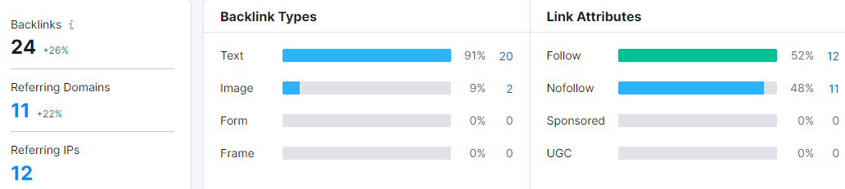
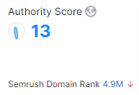
Referring Domain by Authority Score
There are only 24 backlinks available on the website.
Data Source - SEMrush

Slide 29
Website Overview

Slide 30
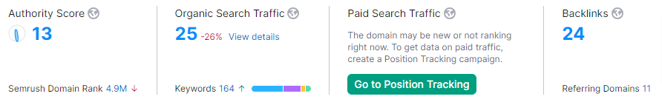
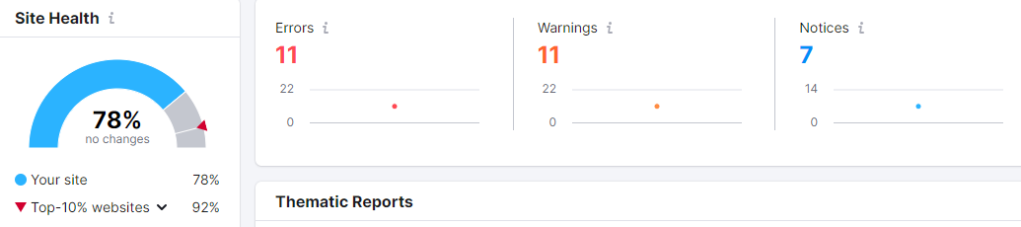
Domain Overview
Objective - To Improve the presence/Traffic in the Cape Town location
Website - https://nitrocommerce.ai/
Domain Authority of your Website
Your Site Health
Data Source - SEMrush

Slide 31
COMPETITOR ANALYSIS

Slide 32
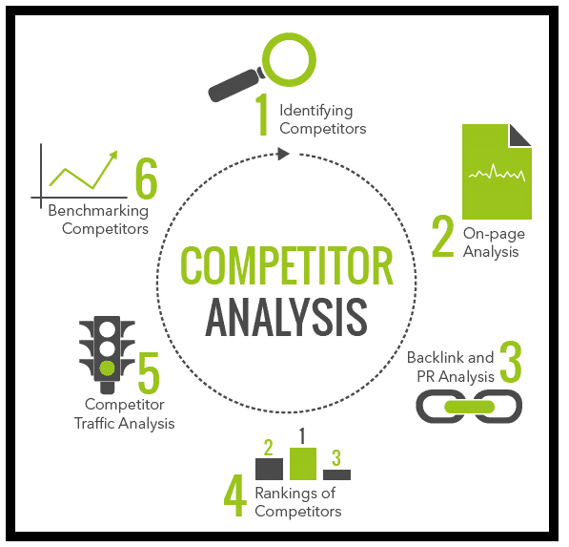
COMPETITOR ANALYSIS
https://www.wunderkind.co/
https://retention.com/
Sample keywords for Ref

Slide 33

DOMAIN OVERVIEW
Competitor’s Website
Your Website
Sample keywords for Ref

Slide 34
3 Months SEO Strategy

Slide 35
Target Keywords
Keywords | Volume | Kd
influencer marketing services | 260 | 48
ecommerce it solutions | 210 | 34
ecommerce solutions | 210 | 37
digital identity blockchain | 210 | 39
ai solutions company | 170 | 49
ecommerce solution provider | 140 | 36
ai tools for ecommerce | 110 | 26
blockchain digital identity | 110 | 35
digital identity solutions | 110 | 23
digital identity verification | 110 | 29
d2c solutions | 50 | 0
gamification advertising | 20 | 0
customize storefront homepage | 20 | 0
ecommerce ai solutions | 10 | 0
ecommerce solution company | 10 | 0
After a quick audit of the services you are offering on your website these keywords were selected.

Slide 36
Quick Summary
On-Page SEO Analysis
Title Tag: Not Appropriate. This is crucial for SEO and should include the main keyword.
Meta Description: Not Appropriate. A compelling meta description can improve click-through rates.
Headings (H1-H5): Not Structured Properly. Headings structure content and improve readability for search engines and users.
Keyword Usage: The keyword “ecommerce solutions" is not found in the URL or body text. Including it naturally is essential for relevance.
Image Alt Text: Some of the Image Alt Text were not detected. Alt text helps with image SEO and accessibility.
Internal and Outbound Links: Not detected. Links are vital for SEO, both for internal navigation and external authority.

Slide 37
SEO STRATEGY
1) Keyword Research:
We will Identify relevant keywords related “ecommerce solutions”. We will optimize the homepage, and service pages using the main & secondary keyword.
2) On-Page Optimization:
Optimize page titles, meta descriptions, and URLs to include targeted keywords.
Incorporate keywords naturally in the content, including product descriptions, category pages, and blog posts.
Use header tags (H1, H2, H3) to structure the content and highlight important keywords.
Optimize image alt tags with relevant keywords for better visibility in image search results.
3) High-Quality Content Creation:
Create blog posts, articles, and guides to improve the E.E.A.T statement. No blogs are currently published. Publish blogs targeting category pages to improve ranking.
4) New Service Pages
New Service Pages will be created with the relevant keywords to target the niche audience.

Slide 38
SEO STRATEGY
5) Headings: There are no H1 tags. Ideally, there should be only one H1 tag per page. Consider restructuring the headings.
Ensure that the H2, H3, and H4 tags are used hierarchically and contain relevant keywords.
6) FAQ: Question & Answers must be added in H3 or H4 tags to improve SEO.
7) There are no backlinks on your website. Our job is to create quality backlinks for your website.

Slide 39
Individual Service Pages Recommendation
Nitro X
Our patent-pending identity identification technology ensures secure and accurate digital identity verification, utilizing blockchain for unparalleled security. This innovative approach helps prevent fraud and ensures the integrity of user identities across digital platforms.
Keywords: digital identity verification, blockchain digital identity, patent-pending identity technology, secure identity identification.
Nitro Collab
Transform micro and nano influencers into effective brand ambassadors with our cutting-edge influencer marketing services. Nitro Collab enhances your brand's reach and engagement by leveraging the authenticity and niche audiences of smaller creators.
Keywords: influencer marketing services, micro influencer marketing, brand ambassadors, influencer collaboration.
Nitro Store
Experience the future of e-commerce with Nitro Store's AI-driven personalized storefronts. Our technology customizes the shopping experience for each customer, providing tailored recommendations and an intuitive interface that increases customer satisfaction and conversion rates.
Keywords: AI-driven personalized storefronts, customize storefront homepage, ecommerce AI solutions, personalized shopping experience.
Nitro AI
Solve your e-commerce challenges with Nitro AI, offering advanced AI solutions designed to optimize operations, improve customer satisfaction, and drive growth. Our AI tools provide actionable insights and automation to streamline your business processes and enhance decision-making.
Keywords: AI solutions company, ecommerce IT solutions, ecommerce solution provider, AI tools for ecommerce.
Nitro Play
Boost engagement and conversion rates with Nitro Play's gamified ads. Our interactive advertisements turn passive viewers into active participants, creating enjoyable experiences that captivate your audience and increase brand loyalty.
Keywords: gamification advertising, interactive ads, enhanced user engagement, gamified advertisements.

Slide 40
New Service Pages Recommendation
Industry
Travel & Hospitality
Optimize guest experiences and streamline operations with our AI-driven and digital identity solutions, enhancing security and personalization.
Manufacturing
Enhance productivity and innovation in manufacturing through AI tools and gamified engagement solutions tailored for industrial environments.
Banking
Ensure secure transactions and compliance with advanced digital identity verification and AI solutions, improving customer trust and satisfaction.
Education
Empower educational institutions with personalized learning experiences and secure digital identities, fostering a safe and engaging environment for students.
Retail
Transform the retail experience with AI-driven personalized storefronts and gamified advertisements, increasing customer engagement and sales.

Slide 41
3 MONTHS ON-PAGE PLAN

Slide 42
Month | Focus Areas | Tasks | Expected Outcomes | Tools
1 | Technical SEO | Website Audit XML Sitemap Update Fix Broken Links Fix All SEO Related Technical Issues Changed to website category structure | Improved website health, better crawling, and indexing by search engines | Google Search Console, Screaming Frog, GTMetrix
2 | On-page SEO (Content Optimization) + Off page Activity 100 Backlinks 3 On –Page blogs + 5 Off page Blogs | Finding profitable keywords to write blogs that will drive website traffic. Adding keywords, SEO titles & meta descriptions to all existing pages on your website. 10 Pages will be optimized per month. Implementing keywords inside your website content to improve ranking. | Improved page relevance, better search engine understanding, increased rankings and website traffic | SEMRush , Ahrtef
3 | On-page SEO (Content Optimization) + Off page Activity 100 Backlinks 3 On –Page blogs + 5 Off page Blogs | Adding Schema Markup Open Graph Tag Strategic Contextual Interlinking. 5 New category pages will be created to target new keywords | Better ranking for new keywords and increased website traffic. | Semrush ,Ahref

Slide 43
Content Strategy
Blog Topic | Search Intent | Keywords
Maximizing Your Reach: The Power of Influencer Marketing Services | Informational | influencer marketing services, brand ambassadors, influencer collaboration
How AI Tools for E-commerce are Revolutionizing Online Retail | Informational | ai tools for ecommerce, ecommerce ai solutions, ecommerce solution company
The Role of Blockchain in Digital Identity Verification | Informational | digital identity blockchain, blockchain digital identity, digital identity solutions
Boosting Engagement with Gamification Advertising in E-commerce | Informational | gamification advertising, interactive ads, enhanced user engagement
Creating Personalized Shopping Experiences with AI-Driven Storefronts | Informational | customize storefront homepage, AI-driven personalized storefronts, personalized shopping experience

Slide 44
3 MONTHS OFF-PAGE PLAN

Slide 45
3 MONTHS OFF-PAGE PLAN
Activity | Description | Possible Outcome | Tools Used
Replicate Competitor's Links | Replicating competitor's links involves using tools like SEMrush or Ahrefs to analyze competitors' backlinks. By mimicking their strategies, such as guest posting or listing on similar directories, you can enhance your site's backlink profile and potentially boost SEO rankings. | Increase in site's backlink profile. | SEMrush, Ahrefs
Reclaim Lost Links | Reclaiming lost links involves identifying and restoring valuable backlinks that your site has lost, boosting your SEO rankings. | Recover lost website ranking. | Google Search Console, Ahrefs
Pursue Unlinked Mentions | Pursuing unlinked mentions involves finding places your brand is mentioned online, then requesting the site owner to turn the mention into a backlink. | Boost SEO ranking and brand visibility. | Google Alerts, Mention
Publish Guest Posts | Write articles on relevant blogs/sites. | Gain traffic and improve domain authority. | OutreachPlus
Find Inferior Content Links | Finding inferior content links involves identifying lower-quality linked content and suggesting your superior content as a replacement to gain quality backlinks | Increase in high-quality backlinks. | Ahrefs, Moz
Pitch Resource Pages | Pitching resource pages involves suggesting your high-quality content to be included in relevant resource pages, thus gaining valuable backlinks | Higher quality inbound links. | Email
Promote Your Content | Spread the word about your content on social media and emailing top website about your content. | Greater visibility, traffic and backlinks. | Social Media, Email
Content Marketing for Backlinks | Content Marketing for Backlinks involves creating compelling content that naturally attracts valuable backlinks. | Earn organic backlinks, boost SEO ranking. | WordPress

Slide 46

Thank You!

