Slide 1
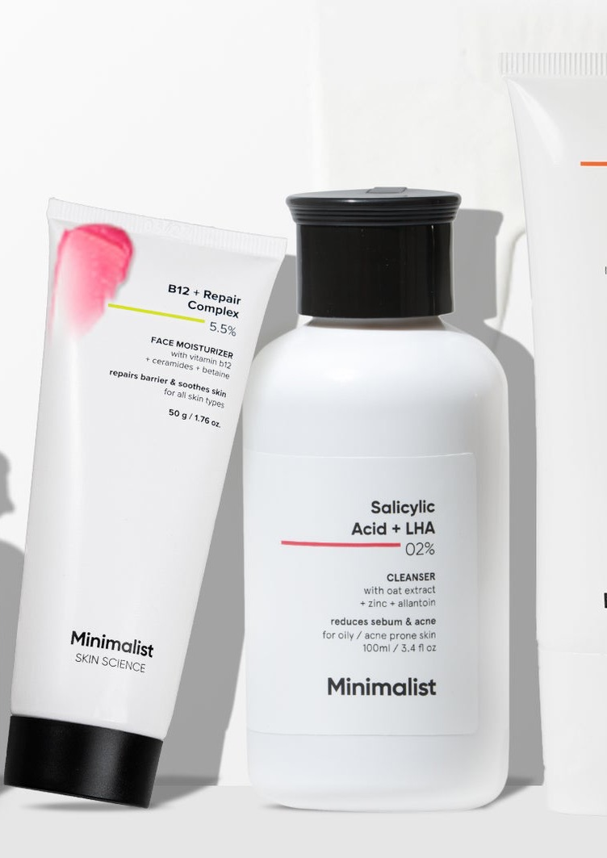
INDEPENDENT PRODUCT MARKETING CASE
MINIMALIST
Skin Journey
A post-purchase decision support concept for active skincare
Strategy, positioning, lifecycle and launch plan
Jyoti Vashisth
Portfolio case study
Notes:
Source: Jyoti Vashisth, user-provided Case Studies new.pdf, pages 36 to 79. Independent strategy exercise. Not commissioned by or affiliated with Minimalist. No launch results are claimed.

Slide 2
MINIMALIST
CASE SCOPE
02
My product marketing strategy
The customer reasoning, launch choices and measurement plan behind Skin Journey
01
02
03
04
05
Customer problem
Product concept
Market story
Launch
Evidence
I found the decision gap after purchase.
I shaped the audience, JTBD and experience.
I built the positioning and message system.
I mapped GTM, assets and team ownership.
I defined metrics, risks and decision gates.
My hypothesis: useful guidance after purchase can build confidence and a stronger customer relationship.
Notes:
Source: Jyoti Vashisth, user-provided Case Studies new.pdf, pages 37 to 79. Independent strategy exercise. Not commissioned by or affiliated with Minimalist. No launch results are claimed.

Slide 3
MINIMALIST
THE CUSTOMER GAP
03
Minimalist already makes it easier to start
The strongest customer support sits before and around the purchase
01
02
03
04
Diagnose
Educate
Recommend
Build a routine
Skin Insights identifies concerns
Ingredients and routines build confidence
Products fit the stated concern
Usage guidance explains the start
DAY 1
The next questions arrive after the routine begins
Am I using it correctly? When should I judge progress? What should I do next?
Notes:
Source: Jyoti Vashisth, user-provided Case Studies new.pdf, pages 37 to 40. Independent strategy exercise. Not commissioned by or affiliated with Minimalist. No launch results are claimed.

Slide 4
MINIMALIST
THE CUSTOMER GAP
04
The decision changes after checkout
BEFORE PURCHASE
AFTER PURCHASE
Which product fits my concern?
How do I know whether my routine is working?
+
Minimalist already answers this through diagnosis, education and product guidance.
I built Skin Journey around this second decision.
Notes:
Source: Jyoti Vashisth, user-provided Case Studies new.pdf, pages 39 to 40. Independent strategy exercise. Not commissioned by or affiliated with Minimalist. No launch results are claimed.

Slide 5
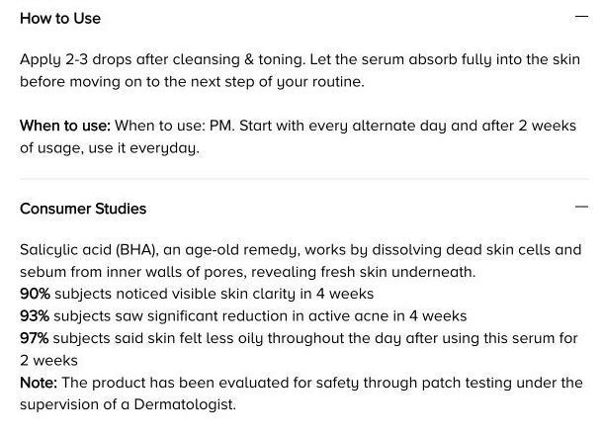
MINIMALIST
RESEARCH & REASONING
05
How I reached the opportunity
I separated the visible product experience from the hypothesis I would test
01 / USAGE RULES
Frequency changes during the start period.
I would check adoption before asking about results.
02 / EVIDENCE WINDOWS
Oiliness: 2 weeks. Clarity and acne: 4 weeks.
I would time each question to the relevant benefit.
03 / MY HYPOTHESIS
Can context make this guidance more useful?
I would test whether contextual check-ins reduce uncertainty.
AUDIT REFRESHED 1 OCT 2026 · MINIMALIST PRODUCT PAGE
Visible evidence supports the opportunity. Customer demand still needs validation.
Notes:
Source: Jyoti Vashisth, user-provided Case Studies new.pdf, pages 37 to 40, 74 to 75. Independent strategy exercise. Not commissioned by or affiliated with Minimalist. No launch results are claimed.
Fresh audit screenshot captured 1 October 2026 from https://beminimalist.co/products/salicylic-acid-2. The original supplied exercise already identifies these usage and evidence windows. Screenshot annotations and lifecycle implications are my strategic interpretation.

Slide 6
MINIMALIST
AUDIENCE & JTBD
06
I would begin where decision friction is highest
A narrow audience makes the first pilot more useful
PRIMARY
Active routine starters
New users of treatment-led products who need help with timing, tolerance and progress.
SECONDARY
Routine optimisers
Existing users deciding whether to maintain, simplify or evolve a multi-product routine.
NOT FIRST
Every skincare buyer
I would exclude low-friction purchases and concerns that require medical diagnosis.
JTBD Help me use this routine correctly, judge it fairly and choose a credible next step.
Notes:
Source: Jyoti Vashisth, user-provided Case Studies new.pdf, pages 42 to 43. Independent strategy exercise. Not commissioned by or affiliated with Minimalist. No launch results are claimed.

Slide 7
MINIMALIST
SEGMENT PRIORITY
07
Why I chose active routine starters first
MARKET SIGNAL
62%
Ingredient interest supports an active-led entry point. It does not prove demand for my concept.
CUSTOMER JOB
These users must judge frequency, tolerance and progress over time, not simply reorder.
of Gen Z search beauty by ingredients rather than brands
PILOT ADVANTAGE
A small product set makes scientific rules and evaluation windows easier to validate.
NEXT SEGMENT
Flipkart × NielsenIQ
Beauty Trends Report 2025
I would add routine optimisers only after return use and useful decisions are demonstrated.
My priority combines category interest, decision friction and a manageable first pilot.
Notes:
Source: Jyoti Vashisth, user-provided Case Studies new.pdf, pages 42 to 43, 55 to 56. Independent strategy exercise. Not commissioned by or affiliated with Minimalist. No launch results are claimed.
Source: Flipkart Glam Up Annual Beauty Trends Report 2025 with NielsenIQ, issuer announcement: https://stories.flipkart.com/announcement/flipkart-unveils-glam-up-annual-beauty-trends-report-2025-at-glam-up-fest-2025-with-nielsen-iq-capturing-the-pulse-of-india-s-love-for-k-beauty-products. The announcement reports 62% of Gen Z searching by ingredients rather than brands. It does not establish demand for Skin Journey or provide a sample size alongside this claim.

Slide 8
MINIMALIST
COMPETITIVE STRATEGY
08
My differentiation goes beyond a skin score
Capabilities described in the source audit informed my positioning
EXPERIENCE
CUSTOMER SUPPORT
L’Oréal Skin Genius
Diagnose, recommend and rescan to monitor progress.
Nykaa Skin Compass
Analyse skin and support product discovery and recommendations.
Independent skin apps
Scan, track progress and provide routine reminders.
My Skin Journey concept
Connect the purchased product, its usage window and reported progress to a relevant next action.
I would compete on product context and decision quality. Tracking alone is already available.
Notes:
Source: Jyoti Vashisth, user-provided Case Studies new.pdf, pages 44 to 46. Independent strategy exercise. Not commissioned by or affiliated with Minimalist. No launch results are claimed.

Slide 9
MINIMALIST
PRODUCT CONCEPT
09
One ecosystem, two different decisions
EXISTING
MY CONCEPT
Skin Insights
Skin Journey
Where should I start?
What should I do next?
+
Diagnosis and routine recommendation help the customer choose.
Product-aware checkpoints turn usage and progress into a credible next decision.
I designed Skin Journey as post-purchase decision support, not another recommendation engine.
Notes:
Source: Jyoti Vashisth, user-provided Case Studies new.pdf, pages 47 to 49. Independent strategy exercise. Not commissioned by or affiliated with Minimalist. No launch results are claimed.

Slide 10
MINIMALIST
POSITIONING LOGIC
10
The positioning I would take to market
FOR WHOM
Customers beginning an active skincare routine who want confidence in usage and realistic expectations.
THE OFFER
Personalised guidance after purchase, adapted to the routine and stage of use.
REASON TO BELIEVE
Minimalist formulates the products and owns their usage guidance. Skin Insights and purchase context can make that knowledge relevant to each customer.
Functional benefit: clearer decisions
Emotional benefit: less second-guessing
I extended the brand’s existing promise of clarity into the weeks after checkout.
Notes:
Source: Jyoti Vashisth, user-provided Case Studies new.pdf, pages 48 to 49. Independent strategy exercise. Not commissioned by or affiliated with Minimalist. No launch results are claimed.

Slide 11
MINIMALIST
POSITIONING & MESSAGE
11
My positioning makes the value easy to repeat
CORE PROMISE
Less guesswork after Day 1
USAGE CONFIDENCE
PROGRESS CLARITY
RELEVANT NEXT ACTION
Know how to use the routine at this stage.
Know what can reasonably be assessed now.
Reassess before automatically adding more.
Guardrail I would never imply diagnosis, guaranteed outcomes or pressure to keep using a product through concerning reactions.
Notes:
Source: Jyoti Vashisth, user-provided Case Studies new.pdf, pages 48 to 53. Independent strategy exercise. Not commissioned by or affiliated with Minimalist. No launch results are claimed.

Slide 12
MINIMALIST
MESSAGE & EVIDENCE
12
How I would support each message with proof
USAGE CONFIDENCE
Message: know how to use the routine at this stage. Support: the product’s own frequency, sequencing and skin-type guidance.
PROGRESS CLARITY
Message: know what can be assessed now. Support: product-specific evidence windows, which vary across benefits and products.
NEXT ACTION
Message: reassess before automatically adding more. Support: the original concern, actual routine and customer-reported changes.
SCIENTIFIC TRUST
Message: guidance comes from the brand that formulated the product. Support: validated instructions, claims and escalation rules.
The promise stays consistent. The explanation changes with the customer’s decision.
Notes:
Source: Jyoti Vashisth, user-provided Case Studies new.pdf, pages 51 to 53. Independent strategy exercise. Not commissioned by or affiliated with Minimalist. No launch results are claimed.

Slide 13
MINIMALIST
PRODUCT EXPERIENCE
13
The checkpoint changes with the answer
My proposed decision logic, subject to Scientific Affairs approval
CONFIRM CONTEXT
Concerning symptoms
Route to approved safety guidance and professional help
Consent
Purchased routine
Actual start date
Original concern
Usage is unclear
Review instructions for the purchased product or routine
Too early to assess
Explain the window; offer a later check-in
Then ask only what is needed for this checkpoint.
Evaluation window reached
Compare with baseline; continue, review or simplify
Activation = the first meaningful product checkpoint plus a relevant next action.
Notes:
Source: Jyoti Vashisth, user-provided Case Studies new.pdf, pages 55 to 60. Independent strategy exercise. Not commissioned by or affiliated with Minimalist. No launch results are claimed.

Slide 14
MINIMALIST
LIFECYCLE DESIGN
14
Evidence shapes my Niacinamide checkpoints
Niacinamide 5% · published consumer-study responses, not results of Skin Journey
WEEK 3
WEEK 4
WEEK 8
90%
97%
93%
Reported less dehydration
Reported reduced irritation
Reported more even tone
Ask about hydration versus the starting point.
Check comfort; safety concerns take priority.
Reassess the original tone concern before recommending more.
Start: confirm approved everyday AM/PM instructions and the actual start date.
Source: Minimalist product page. Study size and comparator not disclosed alongside claims. No individual outcome guarantee.
Notes:
Source: Jyoti Vashisth, user-provided Case Studies new.pdf, pages 59 to 60. Independent strategy exercise. Not commissioned by or affiliated with Minimalist. No launch results are claimed.
Source: Minimalist Niacinamide 5% consumer studies: https://beminimalist.co/products/niacinamide-5-hyaluronic-acid-1. Verified 1 October 2026. Brand-reported subject responses at 3, 4 and 8 weeks. Study sample size, design and comparator are not disclosed in the page section. These are not Skin Journey results, causal proof or individual outcome guarantees.

Slide 15
MINIMALIST
WORKED LIFECYCLE
15
Salicylic Acid needs routine-aware guidance
I would separate usage instructions from the benefit evaluation windows
START
WEEK 2
WEEK 4
NEXT ACTION
Route by routine
97% less oiliness
90% clarity
93% less active acne
Follow the answer
Serum page: alternate-day start. Kit page: twice weekly. I would not merge them; Science must approve the correct route.
Brand-reported study response. I would check usage and tolerance, then ask about oiliness versus baseline.
Brand-reported study responses. I would compare these concerns with baseline, without promising the same outcome.
Continue, review, simplify or seek guidance. A new product is not the default next step.
Sources: Minimalist Salicylic Acid 2% and Anti-Acne Kit pages. Study size/comparator not disclosed. Concept not launched.
Notes:
Source: Jyoti Vashisth, user-provided Case Studies new.pdf, pages 59 to 60, 71. Independent strategy exercise. Not commissioned by or affiliated with Minimalist. No launch results are claimed.
Sources: https://beminimalist.co/products/salicylic-acid-2 and https://beminimalist.co/products/anti-acne-kit. Verified 1 October 2026. Brand-reported consumer study percentages, not outcomes of my concept. The serum page specifies PM use starting on alternate days, then daily after two weeks. The kit page specifies twice weekly, gradually increasing to alternate nights. I would route by purchased routine and seek Scientific Affairs approval for harmonised guidance rather than combine instructions. Study size and comparator are not disclosed.

Slide 16
MINIMALIST
GO-TO-MARKET
16
I would launch narrowly and prove repeat value
The first goal is behaviour validation, not immediate revenue
01
02
03
Eligible cohort
Natural entry
Useful activation
Skin Insights users purchasing selected active-led products
Order confirmation, account, app and post-purchase email
First meaningful checkpoint plus a relevant next action
LAUNCH FUNNEL
Eligible exposure → Opt-in → Setup → Activation → Return → Reassessment → Action
Notes:
Source: Jyoti Vashisth, user-provided Case Studies new.pdf, pages 55 to 57. Independent strategy exercise. Not commissioned by or affiliated with Minimalist. No launch results are claimed.

Slide 17
MINIMALIST
CHANNEL STRATEGY
17
My acquisition and activation strategy
I would reach customers through the intent they have already expressed
WHO ENTERS
Customers with Skin Insights context who buy an eligible active product. I would connect profile and purchase data with consent.
WHERE I INTRODUCE IT
Skin Insights results explain the continuation. Order confirmation links the promise to the product just purchased.
WHERE IT LIVES
The customer account and app hold the Journey. Email or WhatsApp brings the customer back at a relevant checkpoint.
HOW I REDUCE FRICTION
Carry forward known context. Ask only for the start date, products actually used and check-in preference. Avoid a repeated assessment.
The first conversion I would optimise is a useful checkpoint, beyond simply creating a profile.
Notes:
Source: Jyoti Vashisth, user-provided Case Studies new.pdf, pages 55 to 57, 70 to 71. Independent strategy exercise. Not commissioned by or affiliated with Minimalist. No launch results are claimed.

Slide 18
MINIMALIST
PHASED LAUNCH
18
How I would test the launch before expanding
01 / VALIDATE
02 / OPTIMISE
03 / EXPAND
A controlled cohort
Find the useful moment
Extend proven journeys
Introduce the proposition to eligible buyers of a limited product set. Measure opt-in, first checkpoint and initial feedback.
Test onboarding copy, checkpoint timing and channel preference. Study which products and concerns generate return use.
Add product cohorts and more visible entry points once customers return and report better decision confidence.
I would use observed behaviour to decide when Skin Journey becomes part of the wider lifecycle.
Notes:
Source: Jyoti Vashisth, user-provided Case Studies new.pdf, pages 56 to 57, 78 to 79. Independent strategy exercise. Not commissioned by or affiliated with Minimalist. No launch results are claimed.

Slide 19
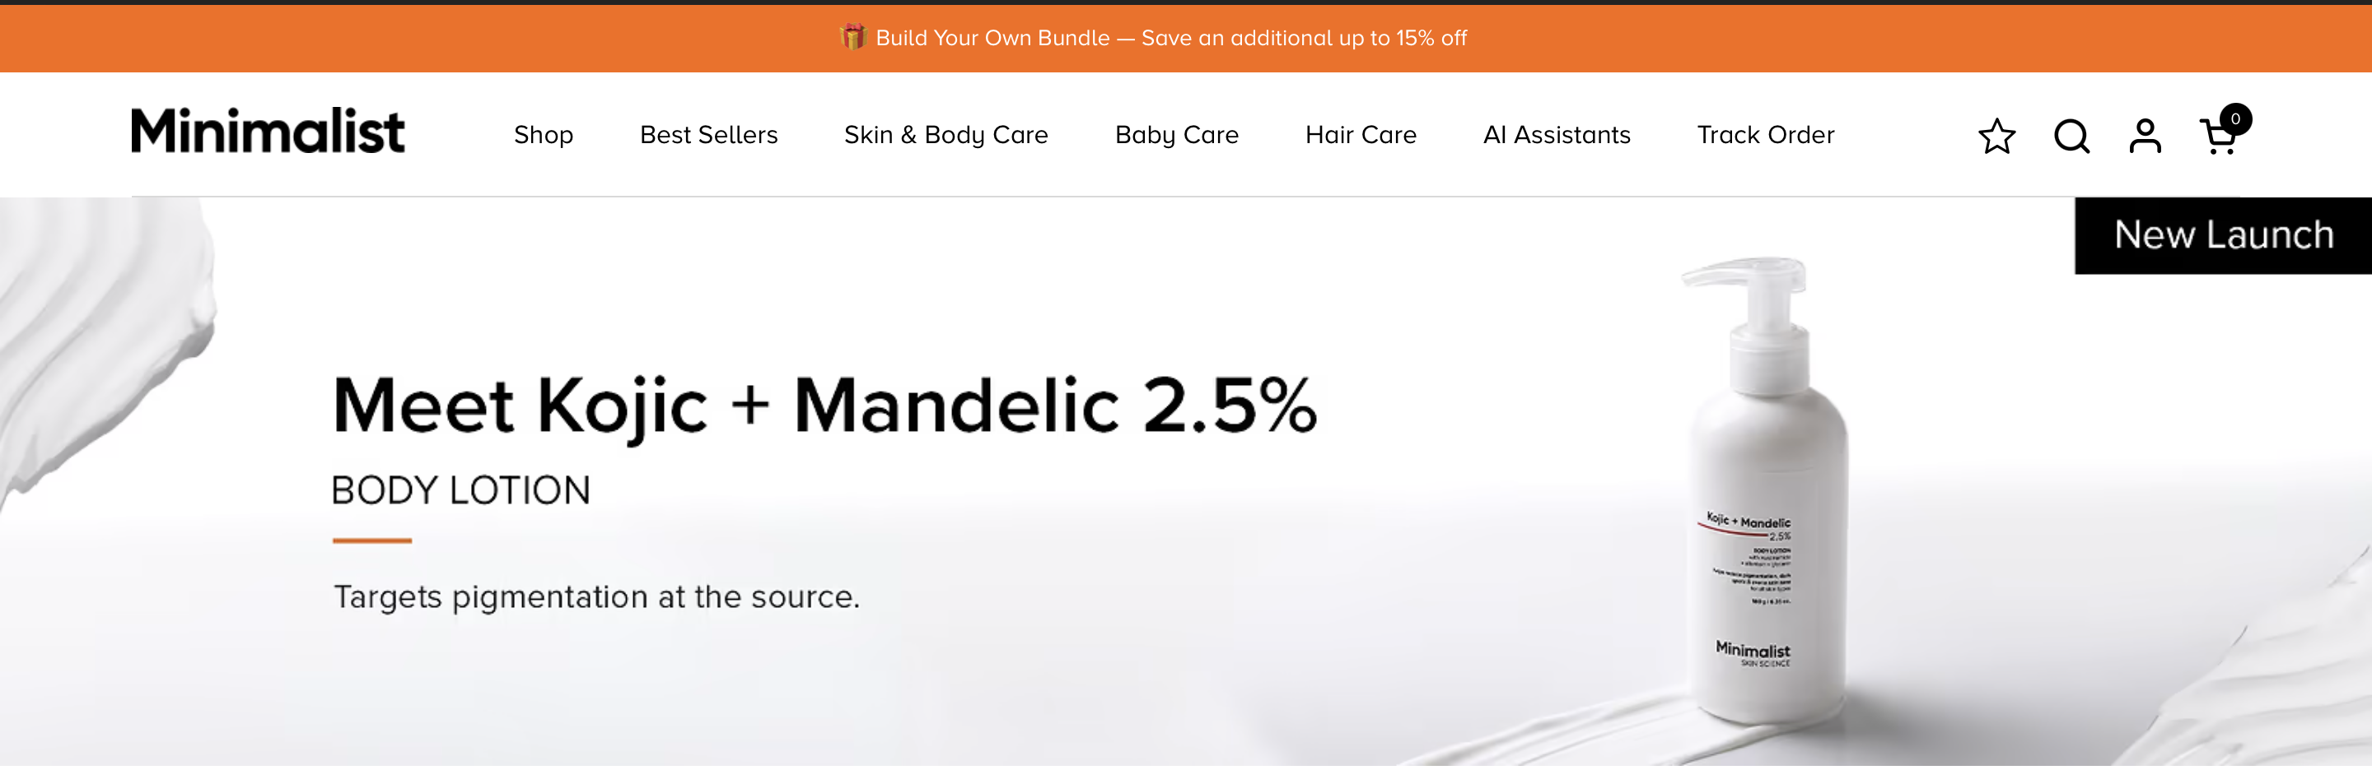
MINIMALIST
LAUNCH ASSETS
19
I translated one promise across the launch system
EXAMPLE COPY
You know where to start.
Now know what
to expect.
OWNED SURFACES
Skin Insights handoff
Order confirmation
Customer account and app
Email and WhatsApp
Support playbook
I would adapt the promise to the product and stage. Each message answers the decision the customer faces now.
Less guesswork after Day 1
Notes:
Source: Jyoti Vashisth, user-provided Case Studies new.pdf, pages 69 to 72. Independent strategy exercise. Not commissioned by or affiliated with Minimalist. No launch results are claimed.

Slide 20
MINIMALIST
COPY & ENABLEMENT
20
The launch copy I would put into use
Illustrative customer-facing copy from the strategy, subject to scientific review
ORDER CONFIRMATION
EARLY CHECKPOINT
REASSESSMENT
Starting Salicylic Acid 2%?
Two weeks into your routine
Let’s compare with your starting point
Understand how to begin, when to assess progress and when to reassess your routine.
Review how you are using the product, what may be useful to assess now and what may need more time.
Tell us what has changed in your original concern. Your next step should follow your progress.
CTA: Start my Skin Journey
CTA: Review my routine
CTA: Complete my check-in
I would also create a support playbook and internal launch kit so every team explains the same value.
Notes:
Source: Jyoti Vashisth, user-provided Case Studies new.pdf, pages 70 to 72. Independent strategy exercise. Not commissioned by or affiliated with Minimalist. No launch results are claimed.

Slide 21
MINIMALIST
CROSS-FUNCTIONAL PLAN
21
My launch plan gives each team a clear handoff
Proposed deliverables and approvals, not completed company work
OWNER
WHAT I WOULD PREPARE
RELEASE CHECK
PRODUCT
Eligibility brief, context fields and journey logic
Flow and data access approved
SCIENCE
SKU/routine rules, claims and safety copy matrix
Every route scientifically signed off
CRM
Trigger map, copy variants and preference controls
Timing and suppression tested
ANALYTICS
Event spec, metric definitions and cohort design
Events and assignment validated
CX + ECOMMERCE
Support playbook, escalation tags and entry copy
Frontline and entry points ready
PMM
Positioning, launch kit and learning readout
One consistent customer promise
Notes:
Source: Jyoti Vashisth, user-provided Case Studies new.pdf, pages 62 to 64. Independent strategy exercise. Not commissioned by or affiliated with Minimalist. No launch results are claimed.

Slide 22
MINIMALIST
MEASUREMENT
22
I defined the denominator before the target
My proposed measurement spec avoids counting setup as activation
NORTH STAR / MEANINGFUL REASSESSMENT RATE
Reassessment + relevant action ÷ activated users whose reassessment is due
OPT-IN
Opted-in users ÷ eligible users exposed to the offer
ACTIVATION
First meaningful checkpoint + action ÷ opted-in users with a first checkpoint due
RETURN
Second checkpoint completed ÷ activated users with a second checkpoint due
SUPPORTING SIGNALS
Decision confidence, repeated support questions and later purchase behaviour
Fix cohort windows before launch. Record action type; a relevant action does not have to be a purchase.
Notes:
Source: Jyoti Vashisth, user-provided Case Studies new.pdf, pages 65 to 68. Independent strategy exercise. Not commissioned by or affiliated with Minimalist. No launch results are claimed.

Slide 23
MINIMALIST
EXPERIMENT DESIGN
23
The experiment I would use to test the idea
TEST COHORT
COMPARISON COHORT
Eligible buyers receiving Skin Journey
Comparable buyers receiving the existing journey
Selected active products, Skin Insights context and consent. Follow customers across the relevant product evaluation window.
Same eligible products and timing. Prefer random assignment where feasible; otherwise use matched cohorts and avoid causal claims.
Observe the full product window, including 8-week tone reassessment where relevant. Track return, confidence and support first; revenue needs longer follow-up.
I would set targets against Minimalist’s own baseline and agree them before the pilot.
Notes:
Source: Jyoti Vashisth, user-provided Case Studies new.pdf, pages 66 to 68. Independent strategy exercise. Not commissioned by or affiliated with Minimalist. No launch results are claimed.

Slide 24
MINIMALIST
RISKS & GUARDRAILS
24
The guardrails protect trust
I treated risks as product requirements, not launch disclaimers
SAFETY FIRST
Scientific approval and clear escalation rules. Never urge continued use through concerning reactions.
NO SALES DEFAULT
Continue, wait, simplify and seek help remain valid next actions. No forced product recommendation.
NO FALSE CERTAINTY
Published study responses guide timing, not personal guarantees or proof that one product caused a change.
LESS MESSAGE FATIGUE
Send only for a meaningful decision. Respect channel preference, opt-out and suppression rules.
MINIMUM DATA
Reuse consented context, ask few questions and define access/retention rules before collecting more.
Notes:
Source: Jyoti Vashisth, user-provided Case Studies new.pdf, pages 73 to 76. Independent strategy exercise. Not commissioned by or affiliated with Minimalist. No launch results are claimed.

Slide 25
MINIMALIST
90-DAY ROADMAP
25
My 90-day plan ends with a decision
The objective is to learn whether Skin Journey deserves to scale
DAYS 0-30
DAYS 31-60
DAYS 61-90
Build
Pilot
Decide
Deliver rules matrix, journey map, copy kit and event spec.
Gate: Science approval, consent flow and tracking QA.
Release eligible cohorts; review activation, return and CX feedback.
Gate: stable routing and no unresolved safety issues.
Read mature cohorts across their product windows.
Gate: credible value and repeat use; extend observation if not yet due.
SCALE
ITERATE
STOP OR REFRAME
I would recommend one path based on activation, return and customer value.
Notes:
Source: Jyoti Vashisth, user-provided Case Studies new.pdf, pages 77 to 79. Independent strategy exercise. Not commissioned by or affiliated with Minimalist. No launch results are claimed.

Slide 26
MINIMALIST
LEARNING & DECISIONS
26
What I would change based on the results
LOW OPT-IN
Review whether I reached the right audience, explained the benefit clearly and introduced it at the right entry point.
STARTS, FEW RETURNS
Review checkpoint timing, message relevance and the value of the next action. Interview customers who stopped using it.
USE, LITTLE CONFIDENCE
Review the guidance itself. More activity without clearer decisions would not support the core product hypothesis.
VALUE, SLOW REVENUE
Observe commercial outcomes for longer. Expand only after customer value and repeat use are convincing.
My role would be to explain the result, recommend the next move and feed learning back into Product.
Notes:
Source: Jyoti Vashisth, user-provided Case Studies new.pdf, pages 67 to 68, 78 to 79. Independent strategy exercise. Not commissioned by or affiliated with Minimalist. No launch results are claimed.

Slide 27
MINIMALIST
CASE SUMMARY
27
What this case demonstrates
I can connect the customer problem, product experience, market story, launch system and evidence plan.
RESEARCH
PRODUCT MARKETING
GO-TO-MARKET
GROWTH & LIFECYCLE
Category, competitor and customer decision analysis
JTBD, positioning, messaging and adoption
Pilot audience, entry points, assets and enablement
Checkpoints, experiments, retention and decision gates
Independent strategy exercise by Jyoti Vashisth. Not commissioned by or affiliated with Minimalist.
Notes:
Source: Jyoti Vashisth, user-provided Case Studies new.pdf, pages 36 to 79. Independent strategy exercise. Not commissioned by or affiliated with Minimalist. No launch results are claimed.

